Slide 1
Clash of Cos
Team Pitch
by Luke Bell, Sam Bagshaw, Sujai Bhuiyan, and Charlie Ashall

Slide 2
Team Introduction
Luke Bell on
Sam Bagshaw on Level Design
Sujai Bhuiyan on Research & asset acquisition
Charlie Ashall on Mechanic Creation
[add images to slides]​
by Luke Bell, Sam Bagshaw, Sujai Bhuiyan, and Charlie Ashall

Slide 3
Overview of Presentation
Summarise talking points:
Notes:
Summary of future talking points

Slide 4
Summary for Clash of Cos
Top-Down Action game
Target Audience – 12+ gamers (silly, but skill level helps)
For PC
[I need to add images to slides]

Slide 5
Research and Inspiration

Slide 6
Genre Inspiration Mash
Fast top-down action game – Hotline Miami (we wanted to combine the balls to wall action of Hotline with the wacky physics of games like Gang Beasts)
Gang Beasts (the most popular of physics fighters made it the easiest to draw inspiration from)
Hades – inspired the inclusion of fake (trashy) "gods" into the narrative to appear as bosses, that due to the wacky tone of the game still give items (a combination with similarity to Isaac).
[add images to slides]​

Slide 7
Environment Inspiration
hotline miami esc level design with realife environment inspiration:
Hotels
Restaurants
Spa
Raves
Storage/supply rooms
(+ Gang beast influence)
[add images to slides]​

Slide 8
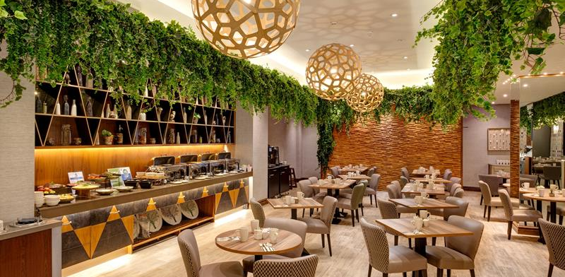
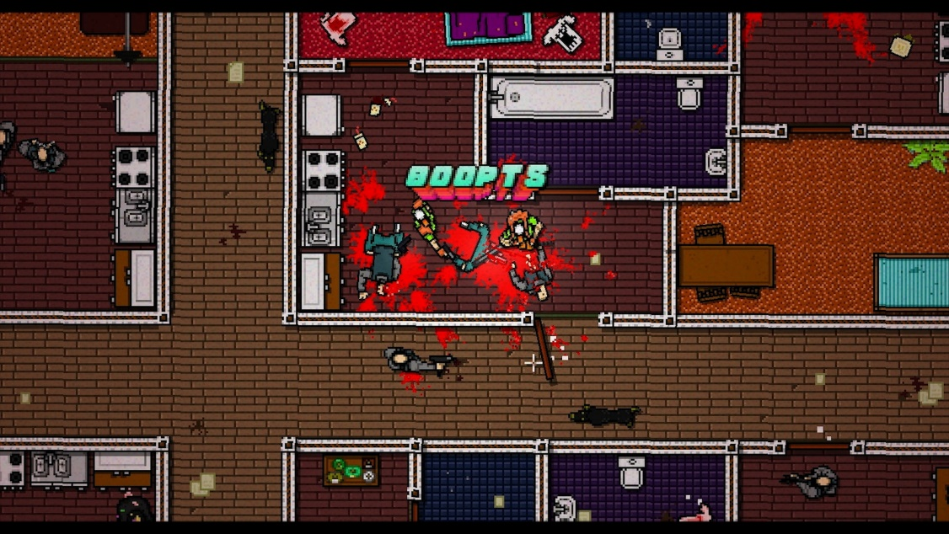
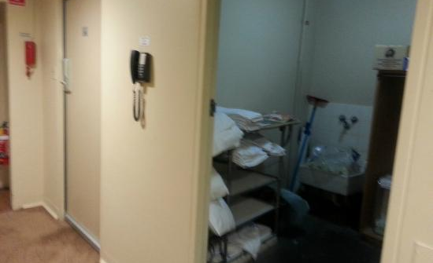
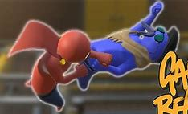
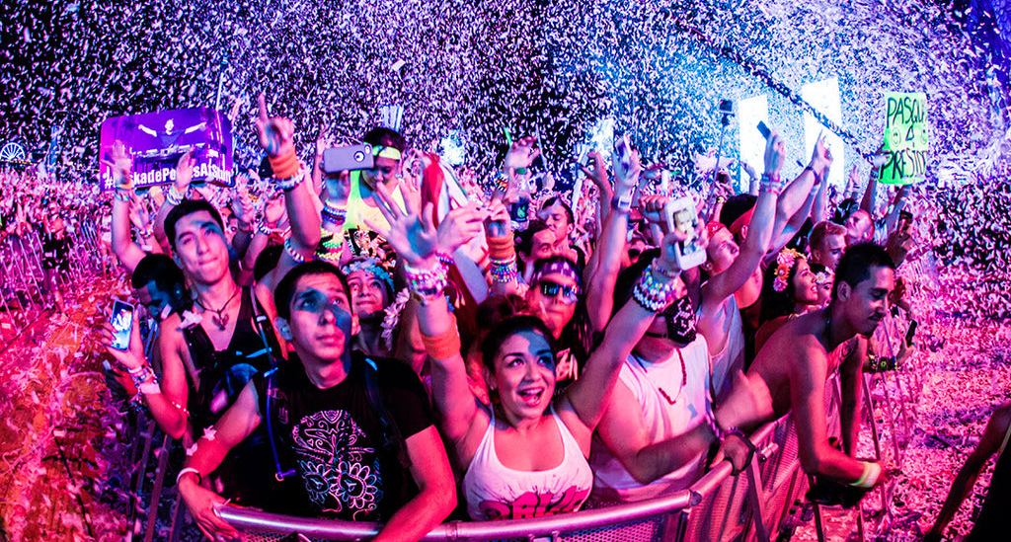
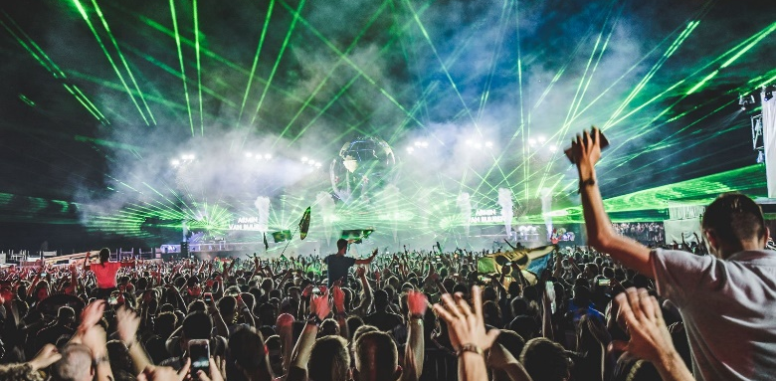
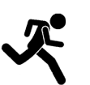

Overall Game Mood-board
Momentum – punch – knockback
Empty hotel turned (rave/show) fight club

Slide 9
Narrative Context
This is a show
Ran by enthusiasts with time to spare
they wear costumes in which they fight each other for entertainment
The most prolific of contestants got to claim a popular character and space for themselves
[add images to slides]​

Slide 10
Mechanics and Gameplay

Slide 11
Gameplay Mood-board/Video/Example
Video Link/Video
[add images to slides]​

Slide 12
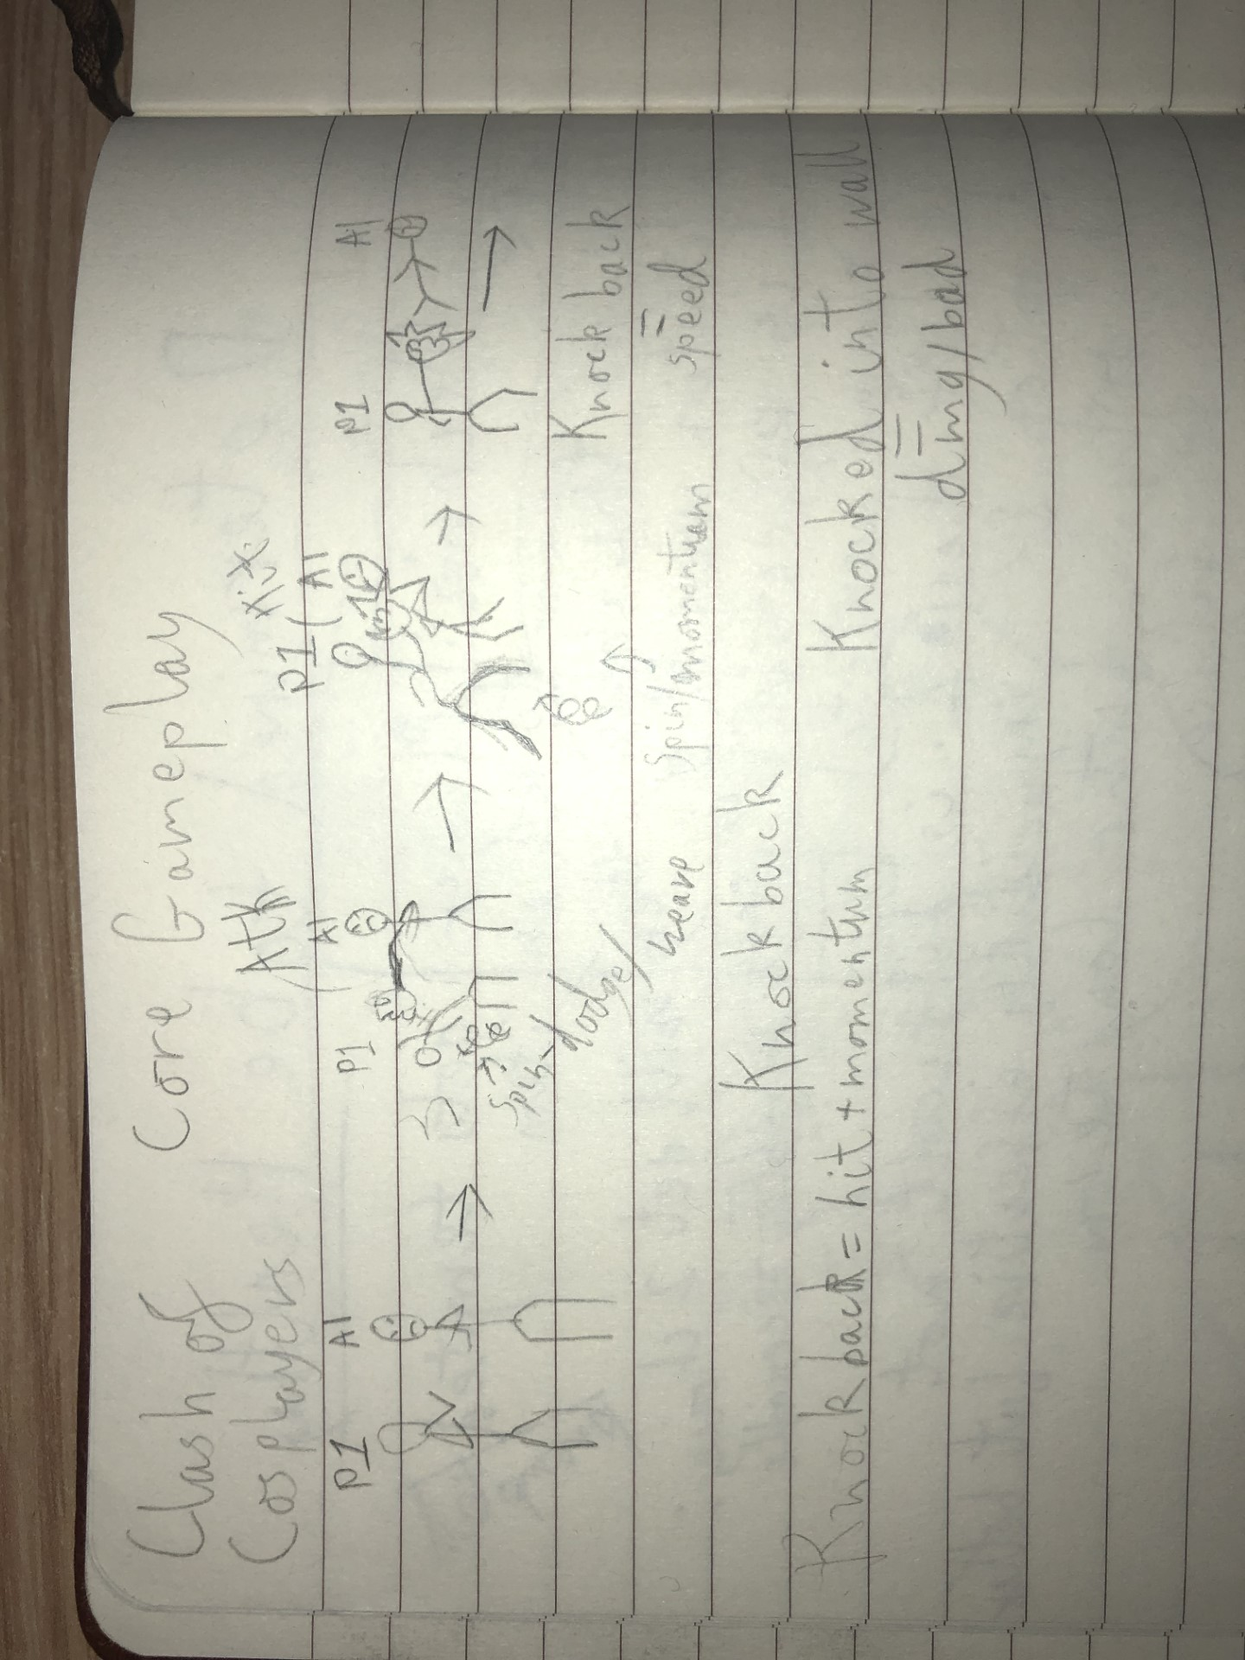
Core Gameplay
Weave/dodge swing/attack ragdoll/knockback/damage
This game hopes to combine that with high speeds and the corresponding dynamic decision-making. Hopefully resulting in wacky game with the most unexpectedly high technical skill ceiling

Slide 13
Core Gameplay Inspiration and Design
We modelled our attacks and dodges on Gang beast
Weave/dodge swing/attack ragdoll/knockback/damage
Physics can be surprisingly technical, dodging then using that momentum to attack. That is what we wanted for ourselves.
This game hopes to combine that with high speeds and the corresponding dynamic decision-making. Resulting in a wacky game with the most unexpectedly high technical skill ceiling

Slide 14
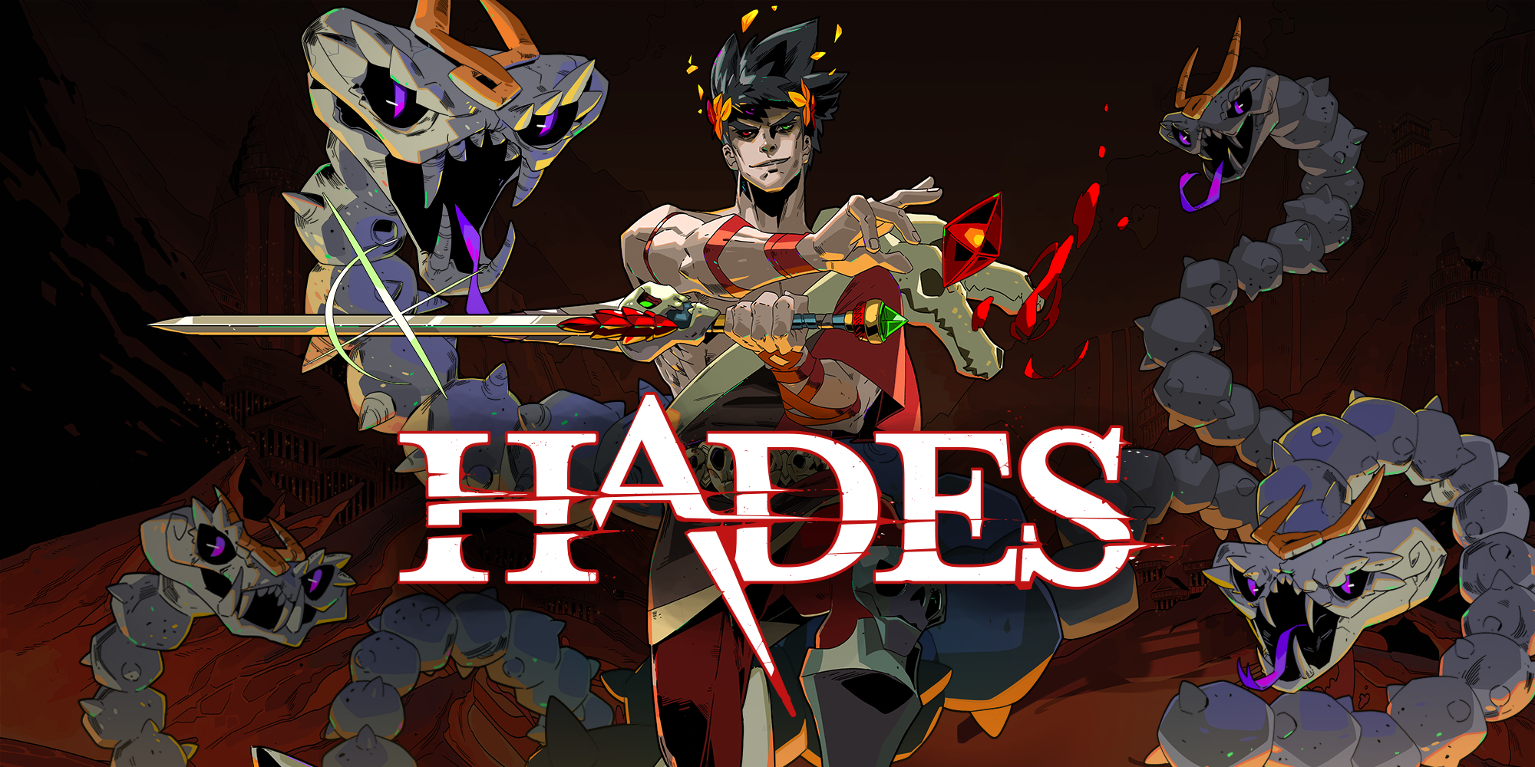
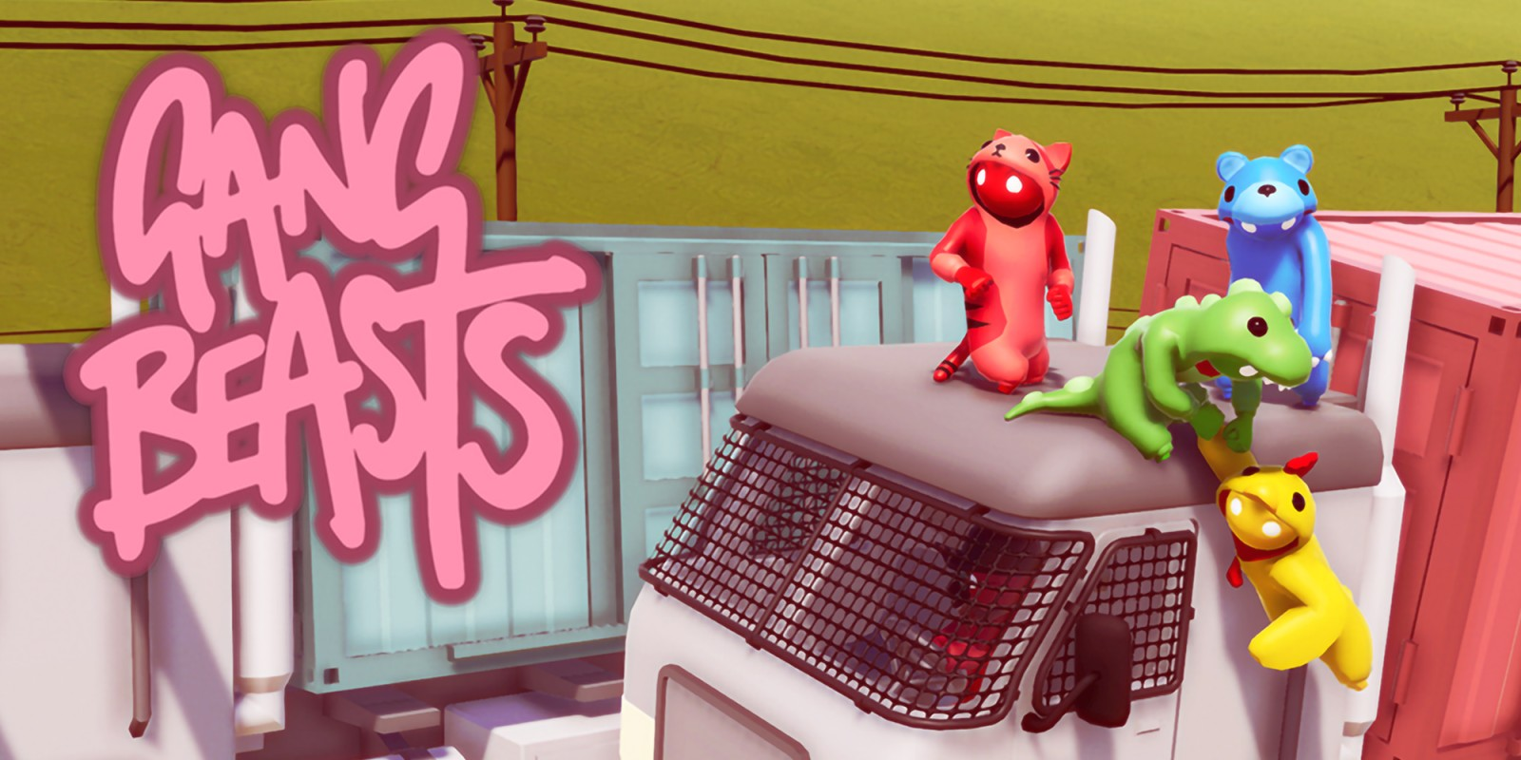
Core Gameplay Implementation & Research
We looked at adding/working around mechanics like the powers/upgrades you would get in Hades, and the ragdoll fighting from Gang Beasts
Using Unreal ragdoll was both easy and a challenge. The best way to use the Ragdoll for our attack was the have the character have a hitbox on the arm and let the player swing the arm in a ragdoll like fashion.
We also worked on some of the ‘Gods’ abilities that the player could use. Zeus would grant the player a taser that can stun enemies. This was simply made by creating a projectile that can be fired after grabbing a pickup and making the enemy stuck in a stun animation if hit
Notes:
When we started our research, we investigated popular top-down games such as Hades and Binding of Issac. One of these games main mechanics were the abilities/powers they could use against enemies or use to upgrade their characters speed or power. We also investigated games like gang beasts, which has a unique and comedic combat system. The player characters fight each other with a ragdoll like element where the players arms flail around punching each other and go limb when knocked out so they can be picked up and thrown around, which added a comedic element.
With our game, we wanted that comedic ragdoll element as well as the top-down combat with unique abilities form the ‘cosplay gods’ to also add on to the comedic effect. One of our mechanics was to make a simple animation to raise the player characters arm, to which the player must then move their character around to swing the arm to hit enemies. A hitbox was attached the characters arm so when the player clicked the mouse, the hitbox would activate so when it overlapped with an enemy character, it would deal damage and activate the enemy's ragdoll and send them flying back from colliding with the characters arm. We also worked one some of the abilities such as ‘zeus’ lighting. This would work by making the player shoot at an enemy which makes them go into a stun animation and leaving them open for the player to attack.

Slide 15
Knock back Design
The knockback acts as a double edge sword
It gives the player more time (also considered ways to kill with it) but also makes finishing enemies off more difficult when fighting multiple
This is true for enemies as well. Knocking the player back could disrupt and panic them. But it also gives the player time to get up before being surrounded by multiple enemies.
Notes:
Could talk about the potential knock back gameplay improvement we didn’t have time
We wanted a better knockback system in place for hitting enemies, but due to time we couldn’t improve on that as we wanted to focus on gameplay and game feel more, so it was an overall more enjoying experience. We also wanted to add it so the player could be knocked out/knocked down in ragdoll before being able to get back up and try adjust to the enemies again in a panic like state as o make the player think on their feet.

Slide 16
Knock back Implementation & Research
As our main mechanic worked with the player needing to swing their arm around to attack enemies, the Collison between their arm and the enemy was enough force to cause a comedic knockback on enemies when they go into ragdoll
The knockback for the enemies would be depended on the momentum of the swing, so that a stronger/wider swing means a bigger knockback.
We also wanted to add a power that would give a greater knockback but decided against it due to both time and focusing on other effects. We also wanted it so the ragdolls could be picked up and swung around to hit enemies, but also dropped this due to time.
Notes:
The knock back element was a simple implement to add as it worked as a Collison. For example, in gang beasts when players hit each other, they get knocked back based on the force/momentum of the attack. As our main mechanic worked with the player needing to swing their arm around to attack enemies, the Collison between their arm and the enemy was enough force to cause a comedic knockback on enemies when they go into ragdoll. The same was also true if an enemy was hit with a punch with little force, so they wouldn't fly back a large distance, making a good physics and Collison system.
However, we did have issues such as enemies being stuck on the player when hitting them. This was an easy fix as we just needed to arrange the ragdolls a little so they wouldn’t become stuck on the player character and would instead be knocked down or knockback by the punch. We also wanted to add a power that would give a greater knockback but decided against it due to both time and focusing on other effects.

Slide 17
Level Designs

Slide 18
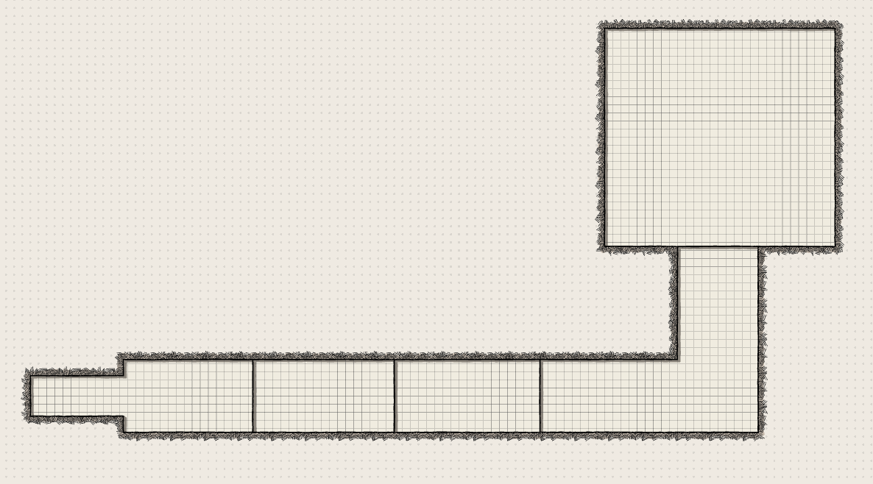
Tutorial Level Implementation & Research
Let Sam talk about this
Tutorial Design Sketch
Get images for Sam to talk about regarding this level’s research

Slide 19
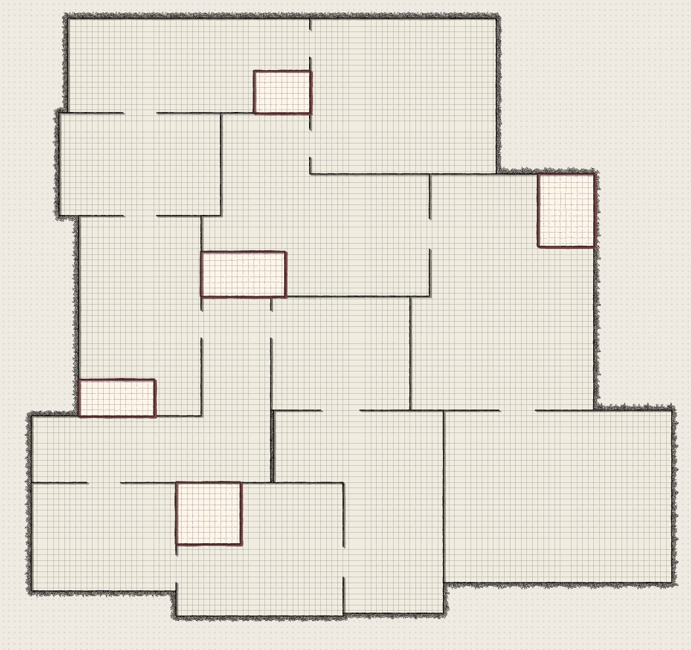
Level 1 Implementation & Research
Let Sam talk about this
Get images for Sam to talk about regarding this level’s research
1st Level Design Sketch

Slide 20
Improvements we would Implement

Slide 21
Variety
Dynamic and fast is challenging at first but like all things you get used to it. Our priority for improvements is providing players with more unique challenges and approaches for instance:
enemy variety – different looks, weapons/equipment, etc
friendly fire – helps add variety when melee enemies' gang up on the player, and entertaining
Items – for the player and enemies to use (e.g., Trolly, Taser, Glass)
Zeus – AI boss enemy – more health – lighting stun attacks – gives taser on defeat
Boss variety

Slide 22
Equipment Mechanic
With varies items to use we would need to implement an equipment mechanic for
We wouldn’t need many buttons, so we could bind each equip key to corelating socket
We would also use this to implement the ability to pickup enemy corpses
Then give enemies this mechanic as well but change the players loss condition to the trashcan condition

Slide 23
Area Claiming Mechanic
Story wise the player is a new contestant fighting veteran contestants that were given their own areas, it stands to reason the player should get their own as well.
Two ways I see it working (maybe do both) allows players to either make a level for other players to challenge, or let each stage be used as communal areas after completion that the players can use as hubs to talk to NPC's with
Note – page too wordy, Summaries this page & add images

Slide 24
Costumes
The enemies are in costume, why not the player too (the only reason is lack of time and resources)
Unlock costume pieces from enemies the player defeats
Notes:
The enemies are in costume, why not the player too (the only reason is lack of time and resources)
Could even unlock costume pieces from enemies the player defeats

Slide 25
Implementation that requires Polish
These are in game, but could use refining to meet our intention

Slide 26
How our teamwork could improve
Process improvements:
Luke probably could have checked in less often, should have given Sujai more to do, could have updated the design documents more during the 3rd-5th weeks, and should have focused less on the group pitch slides.

Slide 27
Interaction
[Controls layout]
We want to include various Environment interactions, so the player has more unique options throughout the levels: scattered items, moveable objects, obstacles, etc

Slide 28
Game to Player Feedback
Ways the game will convey information to the player
Combat
Ragdolls need to be Obvious
Ideally sound effect indicate impact/damage
Progress indicators
An enemy count could work
Announcer comments
Boss Talks

Slide 29
Questions

Slide 30
Posible Questions
How is this different from other top-downs
How would you sell/monatise this
What's your unique selling point
What problems did you encounter/deal with
Why this mechanic
How would you improve it

